Slide 1

CompTIA Network +
Chapter 11
Managing a Network

Slide 2

Objectives
What are some of the more common tools used to physically maintain a network?
What components are involved in configuration management?
What sorts of networking monitoring tools are available to network administrators, and what type of information are included in various logs?

Slide 3

Managing a Network
Even with a network’s increasing dependence on wireless technologies, physical cabling still comprises the critical backbone of a network.
A network management, monitoring, and troubleshooting require a familiarity with variety of cable maintenance tools.
Another key network-management element is documentation.

Slide 4
Maintenance Tools
The number of troubleshooting issues occurring in a network can be reduced by proper installation and configuration of the media and devices.
A network administrator, need to be familiar with a collection of maintenance tools to help diagnose, isolate, and resolve the wiring issue.

Slide 5
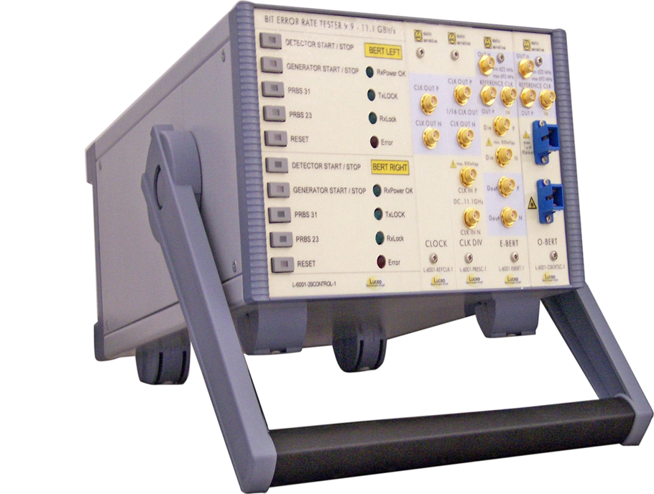
Bit-Error Rate Tester
The bit-error rate tester is used to make sure that the cable can past data with out and errors.
Figure 11-1 Bit-Error Rate Tester (BERT)
(Photo Courtesy of BBN International [ www.bbnint.co.uk ])

Slide 6
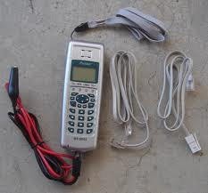
Butt Set
Used by telephone technicians
Connects to punch-down block
Lets the technician butt into a phone call in progress
To check the phone lines when troubleshooting connections

Slide 7
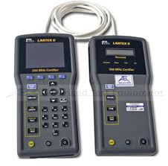
Cable Certifier
The cable certifier is used by the cable installation technician to verify that a newly installed network cable works correctly.
The cable certifier insures that the cable operates at the correct speeds.

Slide 8
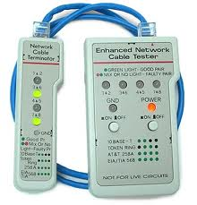
Cable Tester
The cable tester is used by the cable installation technician to test the continuity of the cable.
It verifies that the correct pairs are connected together.

Slide 9
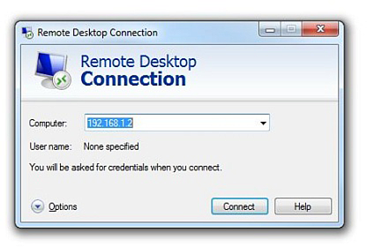
Connectivity Software
When you are physical separated from the network you are maintaining or troubleshooting, you might be able to access the network through remote connectivity software
Examples, RealVNC, GoToMyPC, Remote Desktop Protocol, TeamViewer, LogMeIn
Figure 11-2 Microsoft’s Remote Desktop Connection

Slide 10
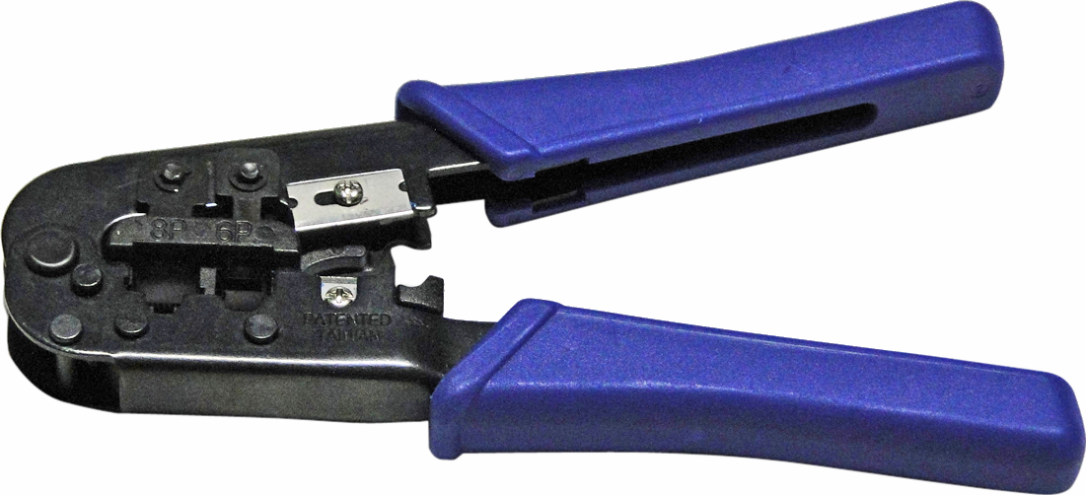
Crimper
The crimper is use to make the cables. It attaches the RJ-45 ends to the cable.
Figure 11-3 Crimper

Slide 11
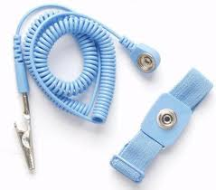
Electrostatic Discharge Wrist Strap
The ESD wrist strap is used to protect the equipment from ESD while you are working in it.

Slide 12
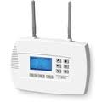
Environmental Monitor
A environmental monitor , monitors the temperature and humidity in the server room, alerting the network administrator if ether our out of tolerance.

Slide 13
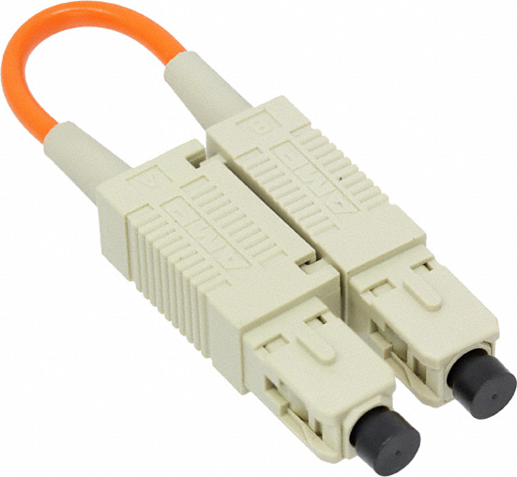
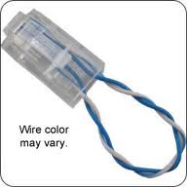
Loopback Plug
A loopback plug allows you to troubleshoot your NIC, to see if it working correctly.
Figure 11-4 Fiber-Optic Loopback Plug (Photo Courtesy of Digi-Key Corporation [ www.digikey.com ])

Slide 14
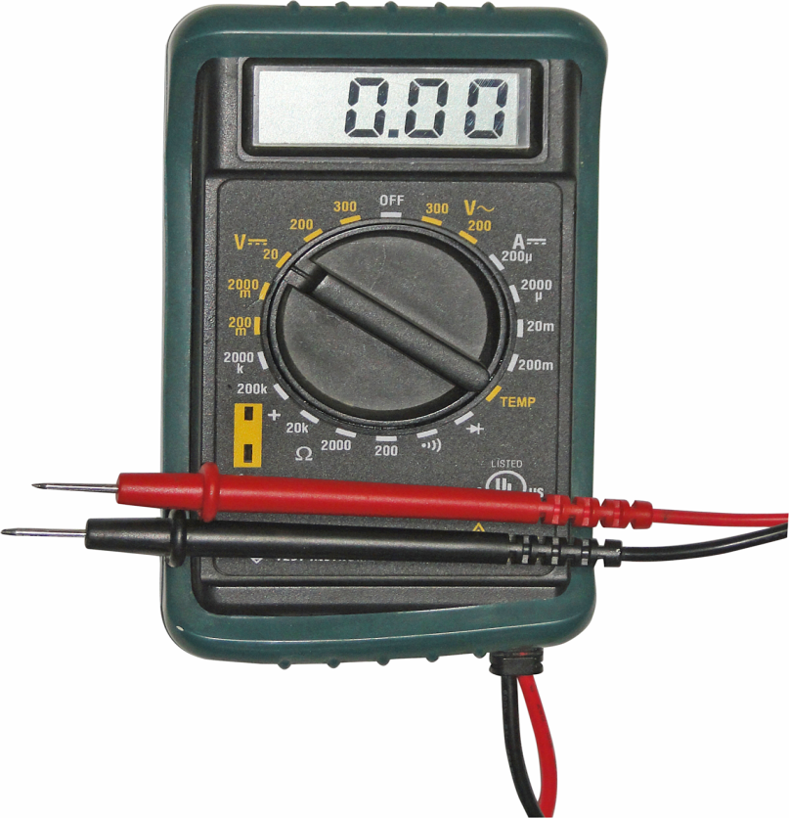
Multimeter
When working with copper cabling, a multimeter can check a variety of a cable’s electrical characteristics.
These characteristics include;
Resistance (Ohms)
Current (Amps)
Voltage (Volts)
Figure 11-5 Multimeter

Slide 15
Protocol Analyzer
A protocol analyzer can be a standalone device or software running on a computer.
You use a protocol analyzer to capture traffic flowing through a network.
By examining the captured packets, you can discern the details of communication flows (session) as they are being setup, maintained, and torn down.
Protocol Analyzer is also known as a network sniffer.

Slide 16
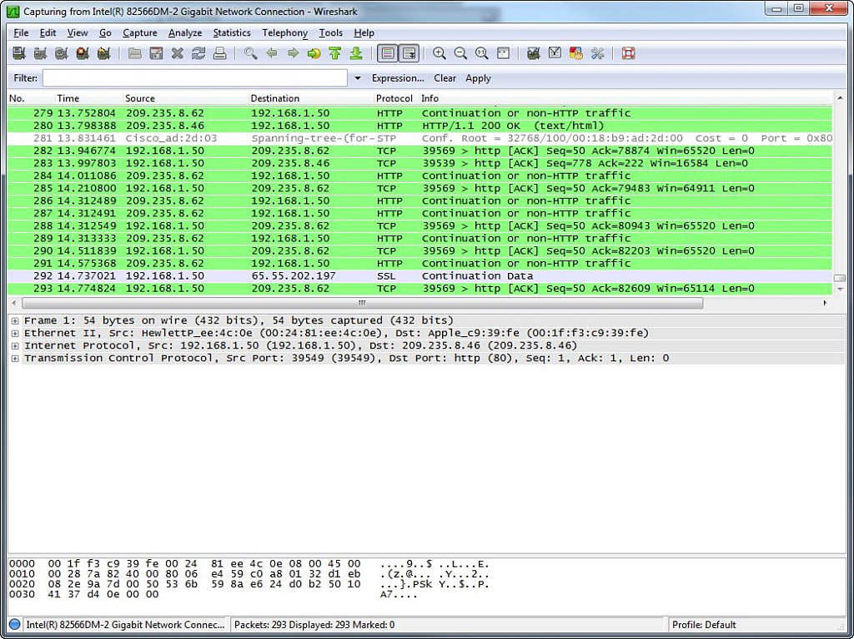
Protocol Analyzer
Figure 11-6 Wireshark Protocol Analyzer Software

Slide 17
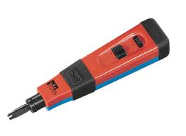
Punch-Down Tool
This tool terminating wires on a punch-down block, an insulated wire is inserted between two contact blades. These blades cut through the insulation and make electrical contact with the inner wire.
As a result, you do not have to strip off the insulation.

Slide 18
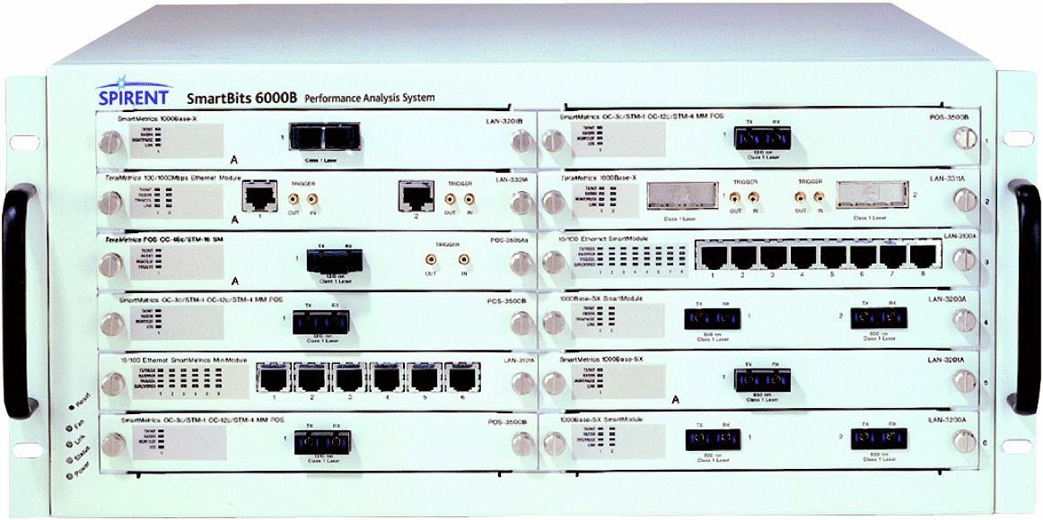
Throughput Tester
Figure 11-7 Throughput Tester (Photo Courtesy of NSS Labs [ www.nsslabs.com ])

Slide 19
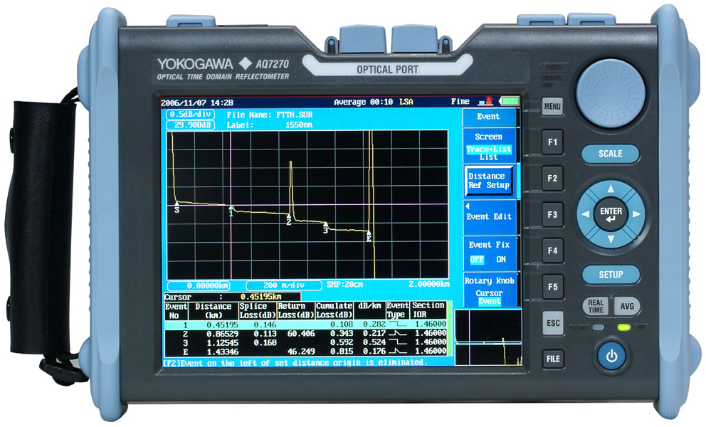
Time Domain Reflectometer Optical Time Domain Reflectometer
Figure 11-8 Optical Time Domain Reflectometer (Photo Courtesy of Coral-i Solutions [ www.coral-i.com ])

Slide 20
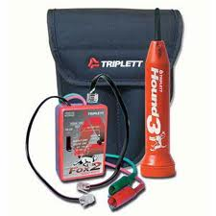
Toner and Probe
A toner probe allows you to place a tone generator at one end of a connection, and use the probe on a punch down block to audibly detect to which pair of wires the tone generator is connected.
Also known as a fox and hound

Slide 21
Configuration Management
Configuration Management (CM) focuses on maintaining up-to-date documentation of network’s configuration.
CM encompasses a variety of procedures, including the following:
Asset Management
Baselining
Cable Management
Change Management
Network Documentation
Contact information
Policies
Network Maps
Wiring Schematics

Slide 22
Monitoring Resources and Reports
Networks administrators routinely monitor network resources and review reports to be proactive in their administration.
Monitoring resources and reports come from various sources, such as a syslog server, a Simple Network Management Protocol (SNMP) server, Event Viewer logs or packet captures from a network sniffer.
SNMP – manage network nodes, such as network servers, routers, switches and hubs.

Slide 23
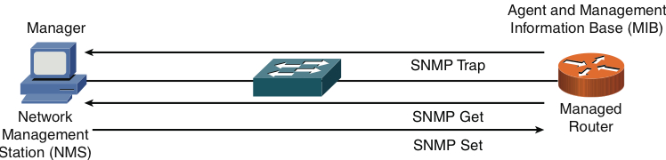
SNMP v1 & 2
Figure 11-9 SNMPv1 and SNMPv2c Network-Management Components and Messages
Trap: Unsolicited message about a significant event
Insecure cleartext transmission of community strings (passwords)

Slide 24
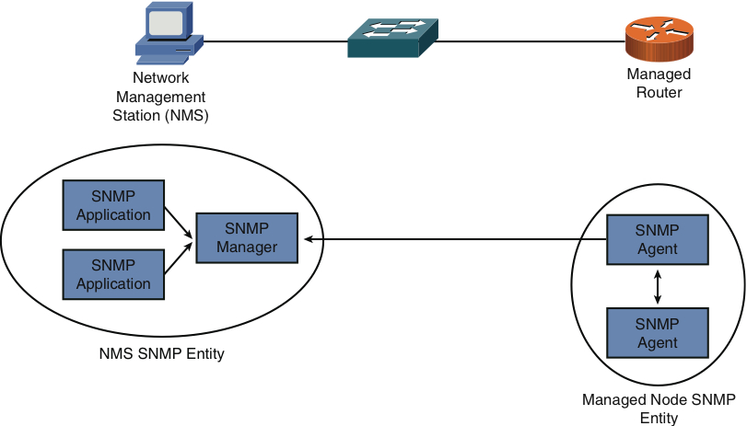
SNMP v3
Figure 11-10 SNMPv3 Entities
Much better security

Slide 25
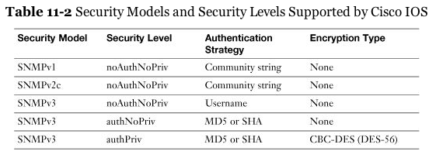
SNMP v3

Slide 26
Syslog
A variety of network components can send their log information to a common syslog server.
By having log information for multiple devices in a common log, network administrators can better correlate events.
Syslog-logging solution consists of two primary components:
Syslog server
Syslog clients

Slide 27
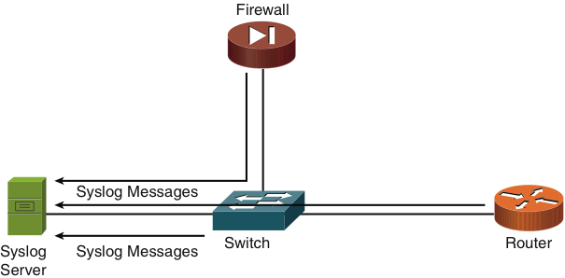
Syslog
Figure 11-11 Sample Syslog Clients

Slide 28
Syslog
Level | Name | Description
0 | Emergencies | The most severe error conditions, which render the system unusable
1 | Alerts | Conditions requiring immediate attention
2 | Critical | A less severe condition, as compared to alerts, which should be addressed to prevent and interruption of service
3 | Errors | Notifications about error conditions within the system, which do not render the system unusable
4 | Warnings | Notifications that specific operations failed to complete successfully
5 | Notifications | Non-errors notifications that alert an administrator about state changes within a system
6 | Informational | Detailed information about the normal operation of a system
7 | Debugging | Highly detailed information (for example, information about individual packets), which is typically used for troubleshooting

Slide 29
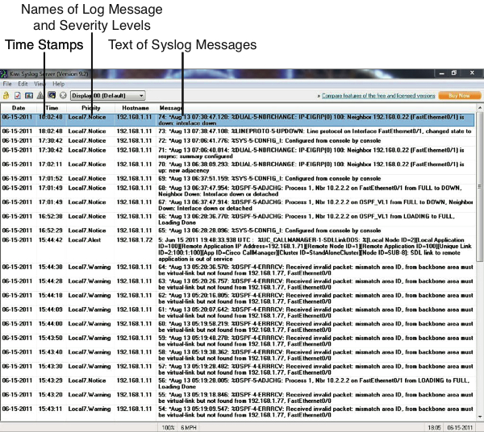
Syslog
Figure 11-12 Structure of a Syslog Message

Slide 30
Logs
In addition to logs generated by routers, switches, and other infrastructure gear, the operating systems powering network clients and servers generally have the capability to produce log outputs.
Microsoft Windows incorporates an Event Viewer application that allows you to view the following logs;
Application
Security
System

Slide 31
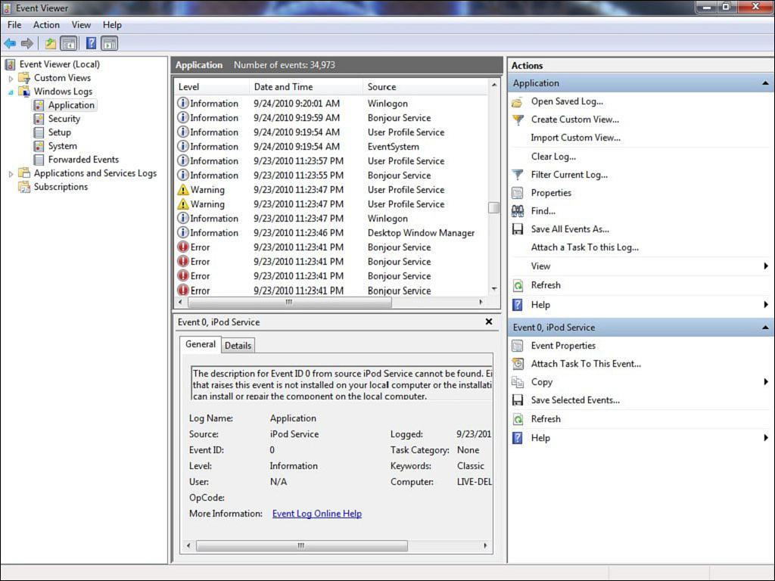
Application Log
Figure 11-13 Application Log

Slide 32
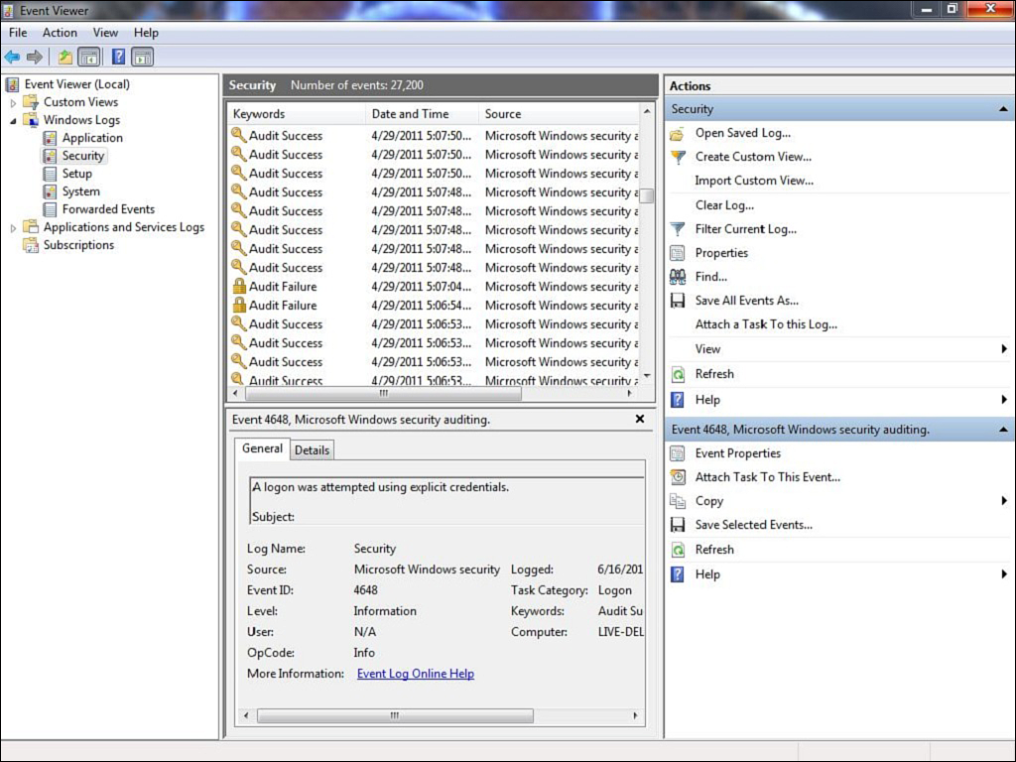
Security Log
Figure 11-14 Security Log

Slide 33
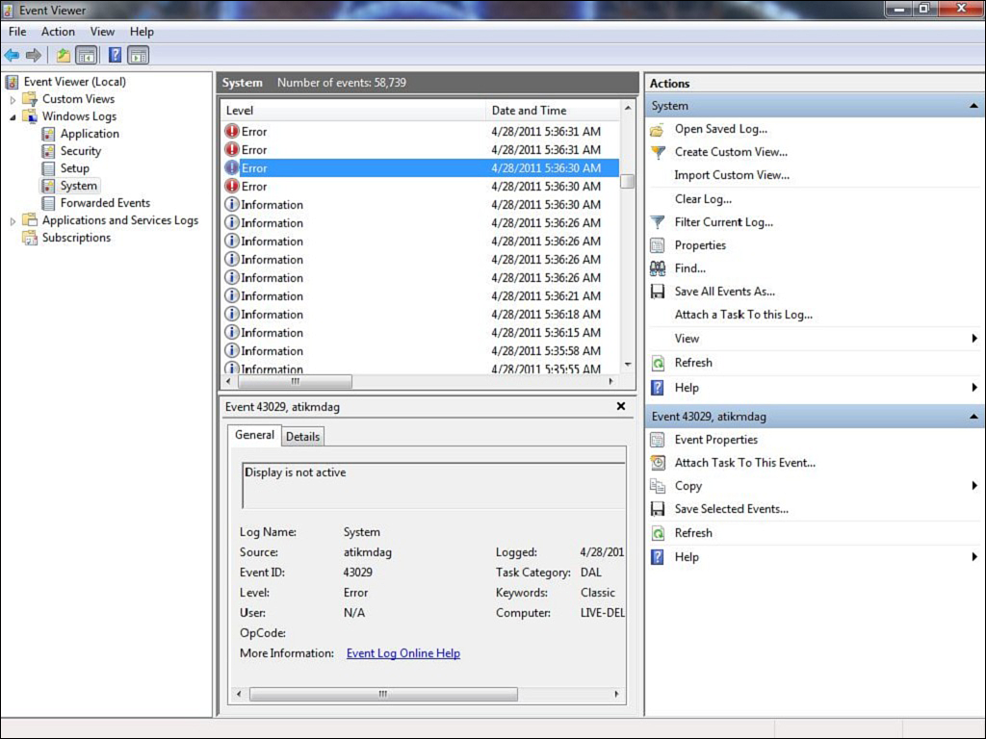
System Log
Figure 11-15 System Log

